Slide 1

Unit: FASTAG FRAUD DETECTION PROJECT
Prepared by: Mr Mashele G.P

Slide 2
AGENDA
1. PROBLEM STATEMENT
2. SOLUTION PROCESS
3. MODELS PERFROMANCE COMPARISON
4. KEY FINDINGS AND RECOMMENDATIONS
5. Q&A

Slide 3
1. PROBLEM STATEMENT
FASTag is an electronic toll collection system in India, operated by the National Highways Authority of India.
It employs Radio Frequency Identification technology(RFID) for making toll payments directly from the prepaid or savings account linked to it or directly toll owner.
The Fastag payment system is adopted in India in order to minimise the hindrances faced by travellers while passing through the toll booths.
The aim of the project is to create a robust model that can accurately identify instances of fraudulent activity, ensuring the integrity and security of Fastag transactions.

Slide 4

2. SOLUTION PROCESS
Example: Cases $a=1$
2.1 About the dataset
The fastag fraud prediction dataset consists of 5000 rows and 13 columns.
The dataset consist of four(4) numerical data columns and nine(9) categorical data.
The dataset has the following columns:
Transaction ID , Date and time(Timestamp)
Vehicle type and Lane Type
Fastag ID & TollBoothID
Transaction Amount and Amount paid for the transaction
Geographical location and Vehicle Dimensions
Vehicle Plate number and Speed
Fraud indicator: Target variable
Le

Slide 5
2. SOLUTION PROCESS
Example: Cases $a=1$
2.1 Data analysis
The dataset contain 549 missing values from the FastagID column.
The fraud indicator consists of an unbalanced dataset.
80.3% of the transaction are without fraud whereas 19.7% constitute fraudulent transactions.
The Vehicle speed data is skewed to the right with mean greater than the median.
25% of the vehicle using the fasttag system make transactions of 100INR(Indian rupees) and above
The amount paid for the Fastag system range from a 0.000 to a maximum of 350.0
75% of the vehicle pass through the Tollbooth travel as a speed of
82 And above to a maximum of 118
Le

Slide 6
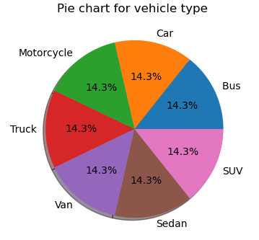
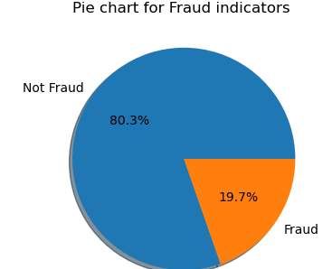
2. SOLUTION PROCESS
Example: Cases $a=1$
2.2 Data analysis :
80.3% of the transaction are without fraud whereas 19.7% constitute fraudulent transactions.
All vehicle type are evenly distributed in term of involvement in the transactions
Le

Slide 7
2. SOLUTION PROCESS(Cont…
Example: Cases $a=1$
2.3 Analytical & Preparations
The dataset consist of inputs (independent variables) and outputs(dependent variables: Fraud indicator).
The classification models, which are supervised learning technique will be used in order to predict the fraudulent activities.
Feature engineering methods will be done in transforming the dataset by creating new features using the existing ones, changing the object/categorical columns with dates with date time format.
Data pre-processing techniques of dealing with missing values, and dropping of unnecessary columns, encoding of categorical variables , normalizing/scaling of features .
Split the dataset into train and validation(testing).
Build and train the classification models such as Logistic regression, Kneighbor classifier, random forest, bagging and boosting and Support vector Machine(SVM).
Le

Slide 8
2. SOLUTION PROCESS(Cont…
Example: Cases $a=1$
2.4 Model preparation
The following steps where followed in model building and evaluation:
1 Perform feature engineering in the dataset
1.1 Changing the timestamps into date time format and convert to month for analysis
1.2 Drop/remove the unnecessary columns such as TransactionID,FastagID and etc.
2 Split the dataset into training and validation/testing dataset
3 Perform data pre-processing before model building
4 Build and fit the classification models for performance evaluation.
Le

Slide 9
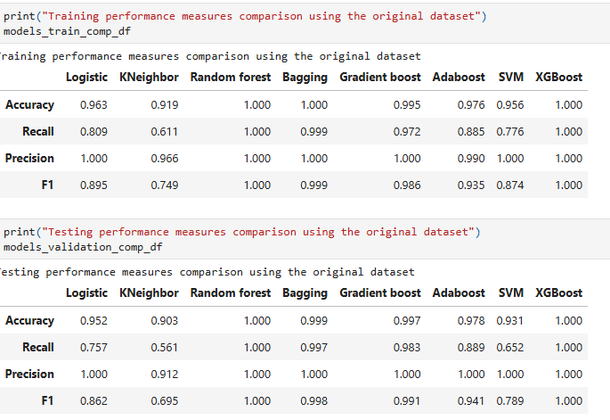
3. Model Comparison

Slide 10
Key findings & recommendation
Several classification models such as logistic regression, random forest ,bagging and boosting where used to build and trained on the training and testing dataset.
Performance metrics for classification such as recall,precision,accuracy and f1-score where used for evaluation.
After tuning the parameters for XGBoost classification model with higher F1 score, accuracy, precision and recall score, it is found that the Transaction amount, amount paid, vehicle dimensions and latitute are the major five determinants for fraud detection.

Slide 11
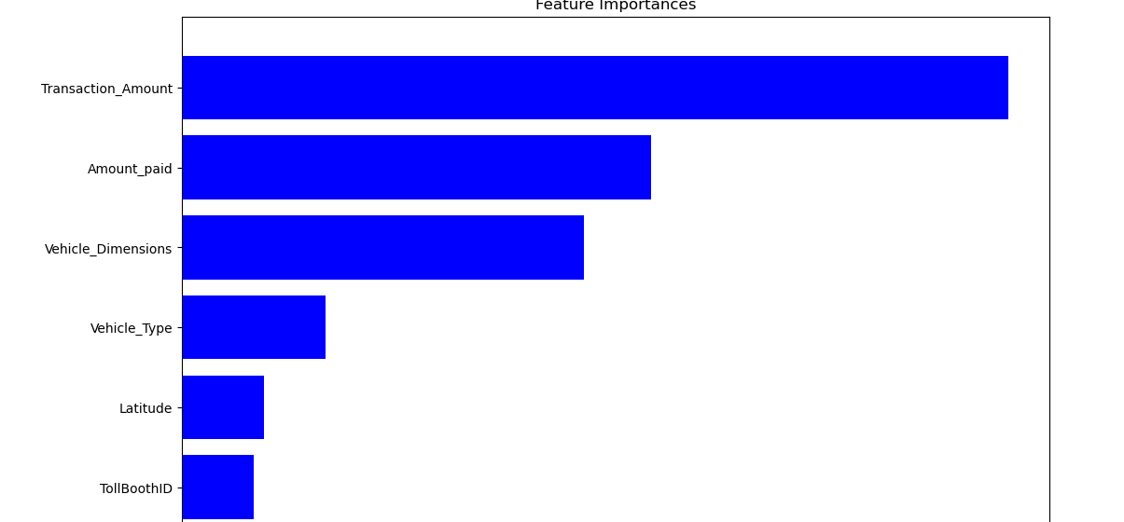
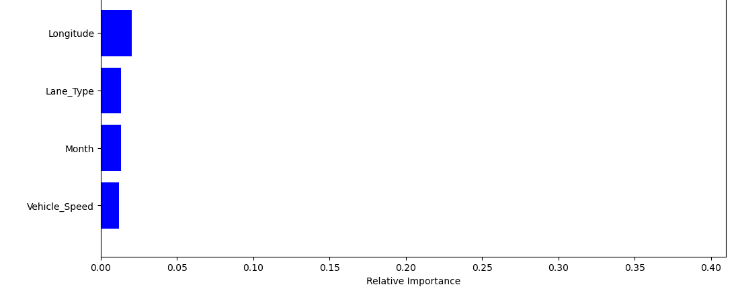
Key findings & recommendation(Continues…)

Slide 12
FASTAG FRAUD DETECTION PROJECT
Q &A

Slide 13
FasTag FRAUD DETECTION PROJECT
THANK YOU

